Slide 1
The Pipeline of Professions Cleaning
RICH.DATA

Slide 2
Current State of Data

Slide 3
Notes:
First the page was scanned to obtain the text and then the text was separated in to a table resulting in nearly 4 million of lines for the entire Paris.

Slide 4
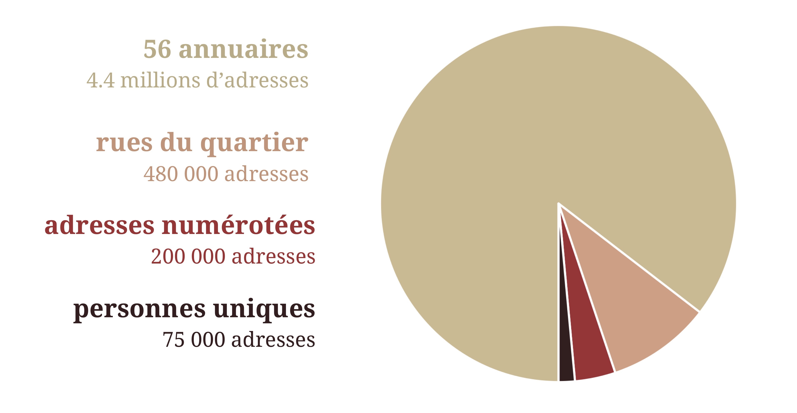
Summary of dataset
Notes:
A subset of data corresponding to Richelieu district was extracted from the above OCRized data.
Separated 200,000 address corresponding to Richelieu district and
Geo referenced the addresses by providing a latitude and longitude.
In summary, they scanned 56 directories, obtained 4.5 million addresses. Extracted 200,000 addresses representing 75,000 unique people in the Richelieu district from 1839 to 1922.

Slide 5
Objective
Normalization and alignment of data from directory extraction
Migration of the Directory data to a public data repository
Notes:
In continuation with previous phase, this internship was planned with 2 ideas. First, normalization and cleaning of the profession so that there appear similar across years. Secondly, make available the data of the 200,000 lines of data for Richelieu district with the cleaned professions and geo referencing to the public by publishing it to a data repository.

Slide 6
Proposed Solution
Create single word tags that are normalization and aligned to represent the profession.

Slide 7
Pipeline
Special Characters
Combine Split Words
Keywords for Profession
Spell Correction of Keywords
Split Combined Words
Add Full Forms
Create a list of words in dictionary
Notes:
The following pipeline has been developed to create tags for each profession. In the first Phase, the special characters are cleaned, then words that are split wrongly are merged. In the second step the strings that represent the profession are split into words. In the third phase, the words that are not correctly split during the OCR process are split and the full forms to the abbreviation shall be added.
The data of 4 million lines will be used and the at the end rows corresponding to Richelieu will be extracted, as they would provide more information of words usage in the directories.

Slide 8
Creation of French Dictionary

Slide 9
French Dictionary
Two online sources Morphalou3 and Prolex-Unitex are used to create the French dictionary like this.
All the words are lower cased.
{
"aalénien": [
"aalénien",
"aaléniens",
"aalénienne",
"aaléniennes"
],
"william pitt, comte de chatham": [
"comte de chatham",
"william pitt",
"william pitt, comte de chatham"
],
"william pitt": [
"william pitt"
]
}

Slide 10
Morphalou3
The data looks like
The dictionary is created as
LEMME |  |  |  |  |  |  |  |  | FLEXION
GRAPHIE | ID | CATÉGORIE | SOUS CATÉGORIE | LOCUTION | GENRE | AUTRES LEMMES LIÉS | PHONÉTIQUE | ORIGINES | GRAPHIE | ID | NOMBRE | MODE | GENRE | TEMPS | PERSONNE | PHONÉTIQUE | ORIGINES
aalénien | 1 | Nom commun |  |  | masculine |  | a l e n j e~ OU a l E/ n j e~ | morphalou2 dela | aalénien | 1 | singular | - | - | - | - | a l e n j e~ OU a l E/ n j e~ | morphalou2 dela
 |  |  |  |  |  |  |  |  | aaléniens | 2 | plural | - | - | - | - | a l e n j e~ OU a l E/ n j e~ | morphalou2
aalénien | 2 | Adjectif qualificatif |  |  | - |  | a l e n j e~ OU a l E/ n j e~ | morphalou2 dela | aalénien | 3 | singular | - | masculine | - | - | a l e n j e~ OU a l E/ n j e~ | morphalou2 dela
 |  |  |  |  |  |  |  |  | aaléniens | 4 | plural | - | masculine | - | - | a l e n j e~ OU a l E/ n j e~ | morphalou2 dela
 |  |  |  |  |  |  |  |  | aalénienne | 5 | singular | - | feminine | - | - | a l e n j E n @ OU a l E/ n j E n @ | morphalou2 dela
 |  |  |  |  |  |  |  |  | aaléniennes | 6 | plural | - | feminine | - | - | a l e n j E n @ OU a l E/ n j E n @ | morphalou2 dela
"aalénien": [
"aalénien",
"aaléniens",
"aalénienne",
"aaléniennes"
]

Slide 11
Prolex-Unitex
The data looks like
The dictionary is created as
comte de Chatham | William Pitt\, comte de Chatham | N+PR+DetZ+Anthroponyme+Individuel+Celebrite:ms
William Pitt |  | N+PR+DetZ+Anthroponyme+Individuel+Celebrite:ms
William Pitt | William Pitt\, comte de Chatham | N+PR+DetZ+Anthroponyme+Individuel+Celebrite:ms
William Pitt\, comte de Chatham |  | N+PR+DetZ+Anthroponyme+Individuel+Celebrite:ms
"william pitt, comte de chatham": [
"comte de chatham",
"william pitt",
"william pitt, comte de chatham"
],
"william pitt": [
"william pitt"
]

Slide 12
List of dictionary words
As seen in above dictionary and other entries, the dictionary does not only contain words but short sentences separated by space, hyphen and it also contains apostrophe to join the complementary pronoun.
complementary pronoun are l, d, s, n, m.

Slide 13
List of dictionary words – split at space and hyphen
a.p. moller-maersk
chien de mer
clin d’œil
aire-sur-l’adour
lac bol'soe eravno
macdonald's corporation
gentleman's agreements
sant'andréa-di-bozio
[a.p., moller, maersk]
[chien, de, mer]
[clin, d’œil]
[aire, sur, l’adour]
[lac, bol’soe, eravno]
[macdonald’s, corporation]
[gentleman’s, agreements]
[sant’andréa, di, bozio]

Slide 14
List of dictionary words – split at apostrophe
a.p. moller-maersk
[a.p., moller, maersk]
chien de mer
[chien, de, mer]
clin d’œil
[clin, d’œil]
Aire-sur-l'Adour
[aire, sur, l’adour]
lac bol'soe eravno
[lac, bol’soe, eravno]
macdonald's corporation
[macdonald’s, corporation]
gentleman's agreements
[gentleman’s, agreements]
sant'andréa-di-bozio
[sant’andréa, di, bozio]
[moller, maersk]
a.p. have less than 3 alphanumeric characters
[chien, mer]
de has less than two alphanumeric characters
[clin, œil]
d is a complementary pronoun
[aire, sur, adour]
l is a complementary pronoun
[lac, bol'soe, eravno]
Although l is complementary pronoun, it is not preceded by space.
[macdonald’s, corporation]
Although d is complementary pronoun, it is not preceded by space.
[gentleman’s, agreements]
Although n is complementary pronoun, it is not preceded by space.
[sant’andréa, di, bozio]
t is not a complementary pronoun

Slide 15
Special Characters

Slide 16
Dealing with Special Characters
., !, &, \, /, “, =, ^, #, `, $, *, %, _, £, (, ), @, +, :, ;, ?, <, >, [,], {, },|.
Completely removed for some characters and manually corrected for few.
The Jupyter notebook contains the steps: Cleaning Special Characters notebook

Slide 17
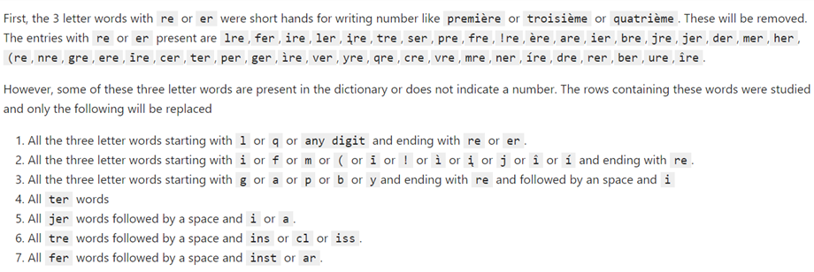
Dealing with Special Characters

Slide 18
Combining Wrongly Split words

Slide 19
Combining Wrongly Split words
During the OCR process, few words are split into parts because of wrong interpretation of the text and/or low quality of the scan and/or presence of text in multiple lines.
The combining of these words to a single word before spell correction is relevant because, the split words might change to a different word.
As the word can be split in an arbitrary fashion, the small words or stop words are not ignored when splitting the profession string into parts.

Slide 20
Combining wrongly split words – split at space and hyphen
produits chimiques pour l'a. griculture
fabr. d'éta lages et d'armures
fabr. de nouveautés au cro. chet et au filet
à la bibliothèque impé| riale
ancien chef de bur. au minist. des financ.
curé de st-thomas-d'a.quin
art.del'op.
[produits, chimiques, pour, l’a., griculture]
[fabr., d’éta, lages, et, d'armures]
[fabr., de, nouveautés, au, cro., chet, et, au, filet]
[à, la, bibliothèque, impé|, riale]
[ancien, chef, de, bur., au, minist., des, financ.]
[cure, de, st, thomas, d'a.quin]
[art., op.]

Slide 21
Combining wrongly split words – split at apostrophe
produits chimiques pour l'a. griculture
[produits, chimiques, pour, l’a., griculture]
fabr. d'éta lages et d'armures
[fabr., d’éta, lages, et, d'armures]
fabr. de nouveautés au cro. chet et au filet
[fabr., de, nouveautés, au, cro. chet, et, au, filet]
à la bibliothèque impé| riale
[à, la, bibliothèque, impé|, riale]
ancien chef de bur. au minist. des financ.
[ancien, chef, de, bur., au, minist., des, financ.]
curé de st-thomas-d'a.quin
[cure, de, st, Thomas, d'a.quin]
art.del’op.
[art., op.]
[produits, chimiques, pour, a., griculture]
l is a complementary pronoun
[fabr., éta, lages, et, armures]
d is a complementary pronoun
[fabr., de, nouveautés, au, cro., chet, et, au, filet]
No change
[à, la, bibliothèque, impé|, riale]
No Change
[ancien, chef, de, bur., au, minist., des, financ.]
No change
[cure, de, st, thomas, a.quin]
No change
[art., op.]
No change

Slide 22
Combining wrongly split words - Algorithm
For each token set,
if either of the consecutive entries are not in the dictionary and either of them have a frequency less than a threshold then try to concatenate these entries

Slide 23
Combining wrongly split words – consecutive words
[produits, chimiques, pour, a., griculture]
[fabr., éta, lages, et, armures]
[fabr., de, nouveautés, au, cro., chet, et, au, filet]
[à, la, bibliothèque, impé|, riale]
[ancien, chef, de, bur., au, minist., des, financ.]
[cure, de, st, thomas, a.quin]
[art., op.]
[[a., griculture]]: [a.griculture]
[[éta, lages]]: [étalages]
[[cro., chet]]: [cro.chet]
[[impé|, riale]]: [impé|riale]
[[bur., au]]: [bur.au]
-
[[art., op.]]: [art.op.]

Slide 24
Combining wrongly split words - Algorithm
For each token set,
if either of the consecutive entries are not in the dictionary and either of them have a frequency less than a threshold then try to concatenate these entries
Check if the concatenated word or a word that is similar with certain threshold exists in the already existing tokens.

Slide 25
Combining wrongly split words
[[a., griculture]]: [a.griculture]
[[éta, lages]]: [étalages]
[[cro., chet]]: [cro.chet]
[[impé|, riale]]: [impé|riale]
[[bur., au]]: [bur.au]
[[art., op.]]: [art.op.]
agriculture
étalages
crochet
impériale
bureau
- No close word in the given threshold range

Slide 26
Combining wrongly split words - Algorithm
For each token set,
if either of the consecutive entries are not in the dictionary and either of them have a frequency less than a threshold then try to concatenate these entries
Check if the concatenated word or a word that is similar with certain threshold exists in the already existing tokens.
If such word exists and if frequency of such new word is greater than or equal to all the individual consecutive tokens used to obtain it, then replace the consecutive tokens with the found word.

Slide 27
Combining wrongly split words
agriculture
étalages
crochet
impériale
bureau
Not changed as the frequency of the new word is less than “a.”
étalages
crochet
impériale
Not changed as the frequency of the new word is less than “au”

Slide 28
Combining wrongly split words
produits chimiques pour l'a. griculture
fabr. d'éta lages et d'armures
fabr. de nouveautés au cro. chet et au filet
à la bibliothèque impé| riale
ancien chef de bur. au minist. des financ.
curé de st-thomas-d'a.quin
art.del'op.
[produits, chimiques, pour, a., griculture]
[fabr., étalages, et, armures]
[fabr., de, nouveautés, au, crochet, et, au, filet]
[à, la, bibliothèque, impériale]
[ancien, chef, de, bur., au, minist., des, financ.]
[cure, de, st, thomas, a.quin]
[art., op.]

Slide 29
Keywords (tokens)

Slide 30
Tokens
After cleaning the special characters and merging mistakenly split tokens, the profession will be divided into words.
The connecting words called as stop words are removed as they appear more frequently and only helps in bringing together the keywords that provide meaning to the profession.
These keywords will be called tokens and after they are normalized they will be called tags.
Process is similar to the splitting string in above two sections with one additional step to deal with two correctly words joined with a dot or apostrophe.

Slide 31
Splitting token
fab.chapeaux de paille
hôt.d'anjou
nég.en miel
h. des etrangers
nulveautés en impression; fabricant de ck'les
négociant.commiss.
employé au ministère de la jus.tice
anc.chef à la justice
fab.di'ustensiles d'imprimerie
fabr.dl'instruments de mathématique
vinš
[fab.chapeaux, paille]
[hôt., anjou]
[nég.en, miel]
[etrangers]
[nulveautés, impression;, fabricant, ck'les]
[négociant.commiss.]
[employé, ministère, jus.tice]
[anc.chef, justice]
[fab.di'ustensiles, imprimerie]
[fabr., instruments, mathématique]
[vinš]

Slide 32
1 - Normal form of words
The tokens that are not in the dictionary are normalized i.e. convert the string to ASCII form.
Example:
æufs to aeufs
vinš, vïns, vịns, viñs, vîns, vỉns, víns, vinş, viņs, vìns, vińs, vīns to vins

Slide 33
Example – Normal form
[fab.chapeaux, paille]
[hôt., anjou]
[nég.en, miel]
[etrangers]
[nulveautés, impression;, fabricant, ck'les]
[négociant.commiss.]
[employé, ministère, jus.tice]
[anc.chef, justice]
[fab.di'ustensiles, imprimerie]
[fabr., instruments, mathématique]
[vinš]
[fab.chapeaux, paille]
[hôt., anjou]
[nég.en, miel]
[etrangers]
[nulveautés, impression;, fabricant, ck'les]
[négociant.commiss.]
[employé, ministère, jus.tice]
[anc.chef, justice]
[fab.di'ustensiles, imprimerie]
[fabr., instruments, mathématique]
[vins]

Slide 34
2 – Splitting tokens with a dot
The tokens that are not in the dictionary and have a dot in the middle are tried to split into separate words.
The algorithm is as follows
Split the token at dot
If majority of the parts after splitting have more than one character then for each part
If there is an apostrophe, split at the apostrophe
For each word part, select the token between the word and word with a dot added at the end, whichever has the higher frequency.

Slide 35
Example – Split at Dot
[fab.chapeaux, paille]
[hôt., anjou]
[nég.en, miel]
[etrangers]
[nulveautés, impression;, fabricant, ck'les]
[négociant.commiss.]
[employé, ministère, jus.tice]
[anc.chef, justice]
[fab.di'ustensiles, imprimerie]
[fabr., instruments, mathématique]
[vins]
[fab., chapeaux, paille]
[hôt., anjou]
[nég., miel]
[etrangers]
[nulveautés, impression;, fabricant, ck'les]
[négociant.commiss.]
[employé, ministère, jus.tice]
[anc., chef, justice]
[fab., di'ustensiles, imprimerie]
[fabr., instruments, mathématique]
[vins]

